Slide 1

GAN Implementation
Fashion image synthesis
Team Members
  Vaibhav Shinde 202301040024
  Gourav Sable 202302040019
  Nabil Ansari 202302040004
  Priyanshu Wagh 202201040135
Guide: Mrs. Savita S. Mane
(Computer Engineering Department)

Slide 2


Content
Introduction
Problem Statement
Objectives
Challenges
Implementation
Comparative Analysis
Use cases
Ethical Concerns
Conclusion

Slide 3
Introduction to GAN
What are GANs?
Generative Adversarial Networks (GANs) introduced by Ian Goodfellow in 2014.
Consist of a Generator (creates data) and a Discriminator (evaluates data).
Models compete in a minimax game: generator tries to fool, discriminator tries to detect.
Specific Architectures:
DCGANs: Use convolutional layers for improved image quality.
cGANs: Allow generation based on specific conditions (labels/classes).
Use Cases: GANs are widely used in image generation, video synthesis, and data augmentation.
Ethical Note: Also pose ethical risks like deepfakes and misinformation.

Slide 4
Problem Statement
Core Problem: Traditional generative models struggle with complex image distributions, lack control, and face training issues. This creates a need for advanced GANs to ensure realistic, diverse, and consistent image generation.
Data Limitations: Real-world datasets are often small, costly, and imbalanced.
Modeling Challenges: Difficulty capturing complex, high-dimensional image distributions.
Generation Issues: Lack of class/content control, training instability, and no standard evaluation metric.

Slide 5
Objectives
  To Implement DCGAN and cGAN architectures for realistic image generation.
  To Train models on a dataset and evaluate outputs.
  To Compare the performance of DCGAN vs cGAN in terms of quality, consistency, and control.
  To Conclude with insights on strengths, weaknesses, and ethical applications.

Slide 6
Challenges
  Mode Collapse : Generator produces repetitive or limited outputs.
  Training Instability – Difficult to maintain balance between generator and discriminator.
  High Computational Cost – Requires powerful GPUs and long training times.
  Evaluation Difficulty –No standardized metrics for image quality assessment.
  Overfitting Risk – Generator may memorize training samples.
  Ethical Risks – Misuse for deepfakes, fake content, and bias propagation.

Slide 7
Implementation
  Google Colab Link: https://colab.research.google.com/drive/1OOaoV86XC42tPXoXDEXlcvbF2jMBRTK5?usp=sharing
  Dataset Used : Fashion MNIST
  For implementation, we used the MNIST dataset, a widely recognized benchmark in computer vision research.
  It consists of 60,000 training images and 10,000 test images, each being a 28x28 grayscale digit (0–9).
  MNIST was chosen due to its simplicity, structured representation, and suitability for testing generative models in producing recognizable outputs.

Slide 8
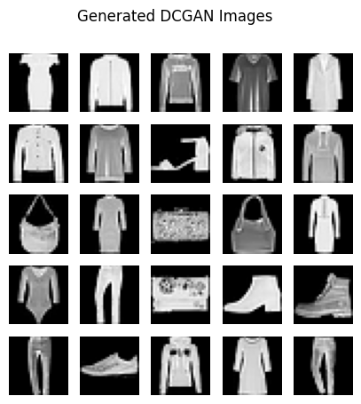
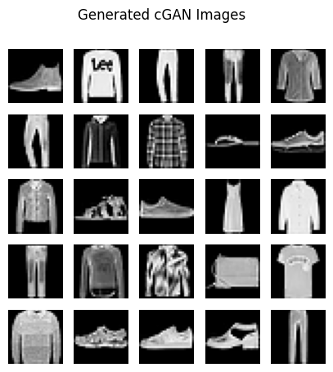
Implementation Output
DCGAN
CCGAN

Slide 9
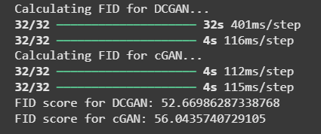
Comparative Analysis
In comparing DCGAN and cGAN, our results show that DCGAN achieved a lower FID score (52.67) compared to cGAN (56.04), indicating higher image quality and closer resemblance to real data. DCGAN’s outputs were generally sharper and visually more appealing, making it well-suited for generic image synthesis. On the other hand, cGAN demonstrated its strength in conditional generation, producing class-specific images with greater control, although at the cost of slightly lower quality. Overall, DCGAN outperforms in quality.

Slide 10
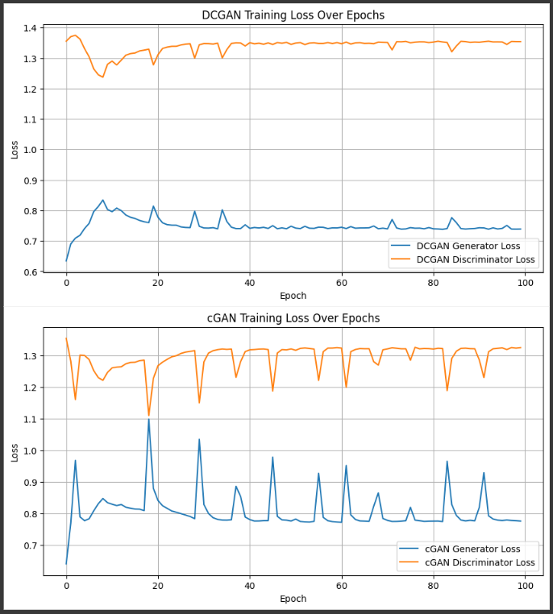
Comparative Analysis

Slide 11
Use Cases of fashion image synthesis
  Virtual Try-On: Generate outfits on digital avatars.
  Design Prototyping: Designers can quickly test new patterns and styles.
  Catalog Creation: Automatically generate diverse product images for online stores.
  Personalized Fashion: Create customized designs based on user preferences.
  Data Augmentation: Enrich training datasets for other AI models.

Slide 12
Ethical Concerns & Challenges
  Copyright: Unclear ownership of AI-generated images.
  Job Automation: AI may automate roles of human artists and designers.
  Result: Raises questions about the future of creative industries.
  Summary: We must address these challenges for the responsible use of GANs.

Slide 13
Conclusion
Generative Adversarial Networks (GANs) have proven to be highly effective for synthetic image generation, offering significant advancements in both quality and diversity. Our experiments with DCGAN and cGAN highlight their complementary strengths—DCGAN produces visually sharper and higher-quality images, while cGAN enables class-specific control over generation, making it more useful for targeted applications. However, both models face challenges such as training instability, high computational cost, and ethical risks, particularly in relation to deepfakes and data misuse. Future research must address these challenges through improved architectures like WGAN and StyleGAN, better evaluation metrics, and a stronger emphasis on ethical responsibility, ensuring GANs are leveraged for constructive and impactful innovations.

Slide 14


THANK YOU!

